Slide 1

COM7302 – Research Methods
Welcome
Session 1

Slide 2

Qualitative Data Analysis Techniques
Lecturer 8

Slide 3

By the end of the session, you should be able to…
…understand and apply qualitative data analysis techniques specifically relevant to fields like Computer Science, Information Systems, and Cybersecurity.
you'll be able to identify and apply key qualitative data analysis methods in your research projects.

Slide 4

All the resources will be posted to the Moodle page
https://moodle.bolton.ac.uk/course/view.php?id=32407

Slide 5

Qualitative Research - Plan
What is qualitative research?
Qualitative data collection.
Qualitative data analysis.

Slide 6

What is Qualitative Research?
Definition: Qualitative research involves examining non-numeric data sources such as texts, videos, or interviews to gain an in-depth understanding of complex situations.
Purpose: To explore scenarios and phenomena where numbers alone can’t provide insight. This may include personal stories, social patterns, or cultural perspectives.
Examples of Data Sources:
Text responses, interview transcripts, videos, images, and audio files.
Goal: Translate unstructured data into a structured format for deeper analysis, often leading to findings that can be adapted for quantitative analysis.
Text – transcripts,
Open question responses,
Images, Video, Audio
Notes:
Techniques Based on Mathematics & Statistics such as:

Slide 7

Qualitative Data Analysis
Qualitative is an inductive approach. In general terms, scientific research consists of an investigation that:
Seeks answers to a question
Systematically uses a predefined set of procedures to answer the question
Collects evidence
Produces findings that were not determined in advance
Produces findings that are applicable beyond the immediate boundaries of the study
Qualitative research is especially effective in obtaining culturally specific information about the values, opinions, behaviours, and social contexts of particular populations.

Slide 8
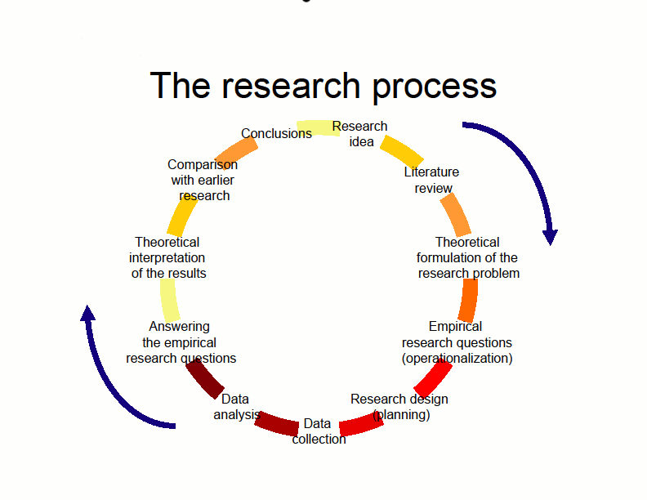
Three Stages of Qualitative Research
Data Selection or Creation: Identify or generate relevant qualitative data based on research questions.
Data Analysis: Apply systematic techniques to extract themes, codes, or patterns.
Conclusion Generation: Derive insights that are applicable beyond the immediate study context.
  Example Activity: Analysing voice command data from devices like Google Home/Alexa to identify common usage patterns.
Stage 1:
Obtain recordings of voice commands for Google Home
Stage 2:
For each recording, determine purpose of the command
Stage 3:
Find most common command types

Slide 9
Data Collection Methods
Notes:
Let us look at two examples of techniques used in quantitative data analysis:

Slide 10
Comparison of different data collection methods
Method | Advantages | Limitations
Questionnaires | Cheap and easy to administer | Rigid structure with no chance to follow up
Interviews | Deep and rich single person perspective | Costly to collect a large amount of data
Focus Groups | Cost effective, large amounts of data. Group dynamics can generate interesting new data. | Dominant members can take over the conversation.
Field Studies (involved) | Experienced-based data collection. Natural setting. Positive participant engagement. | Biased analysis. Alter behaviour of participants.
Observations (detached) | Outsider view can see patterns easily. | Limited ability to probe for details
Internet-based observations | Large amounts of readily available data about a wide range of topics | Ethical concerns about consent and data protection
Diary Studies | Good for long-term studies and when privacy is of concern. | Normally requires incentives due to high effort from participants

Slide 11

Data Collection Methods
Duration: 20 -25 minutes
Objective: To help you explore real-world examples of how different qualitative data collection methods are used in research, by analysing academic papers...
Task Description
Paper Search and Review (15 minutes):
Divide the students into small groups (2-3 students per group).
Each group must choose one of the QUAL methods (Interviews, Focus Groups, or Observations etc from the cheat sheet).
Task:
  In your group quickly search for an academic paper (e.g., from Google Scholar, university databases) that uses their assigned method.
  After finding a relevant paper, students will:
    Summarize the research question the paper addresses.
    Describe how the data collection method is applied in the study.
    Identify any strengths and challenges mentioned in the paper regarding the method's use.
    Provide an appraisal of the data analysis methods
Group Presentations (5 minutes): (OPTION – Deliver the presentation through the Medium of DANCE)
Each group will briefly Discuss:
  The key points from the paper they found.
  How the method was applied and any challenges faced by the researchers.
  How they approaches the Analysis of the data
Class Discussion: Reflect on how the use of data collection methods differs depending on the research context and study needs.

Slide 12
Data
Analysis
Techniques
Notes:
There are different techniques of qualitative data analysis. Which one you choose will depend on the type of data you collect, your preferences, and your research goals.

Slide 13


Analyse Data (Content) – In a nutshell
Take unstructured data (text) and convert it to structured data for analysis.
Process must be systematic and replicable.
Goal is to generate knowledge from the unstructured data.

Slide 14
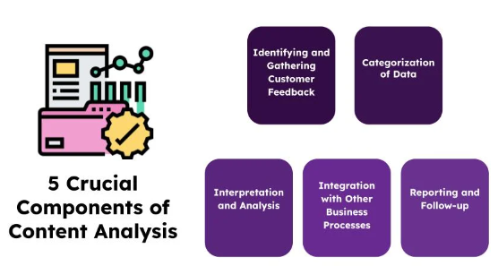
Content Analysis
Content analysis-- Content analysis is a qualitative data analysis method that systematically analyses a text to identify specific features or patterns.
This could be anything from a customer interview transcript to survey responses, social media posts, or customer success calls.
The data is first coded, which means assigning it labels or categories.
For example, if you were looking at customer feedback, you might code all mentions of “price” as “P,” all mentions of “quality” as “Q,” and so on. Once manual coding is done, start looking for patterns and trends in the codes.

Slide 15
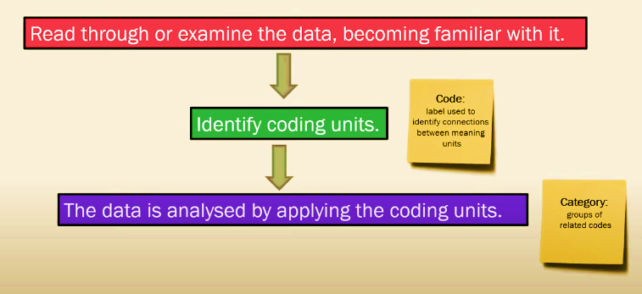
Steps involved in Content Analysis
Summarise the Data

Slide 16
Content Analysis
Advantages of content analysis process
Rich insights: Content analysis can provide rich, in-depth insights into how customers feel about your product, what their unmet needs are, and their motives.
Easily replicable: Once you have developed a coding system, content analysis is relatively quick and easy because it’s a systematic process.
Affordable: Content analysis requires very little investment since all you need is a good understanding of the data, and it doesn’t require any special software.
Disadvantages of content analysis process
Time-consuming: Coding the data is time-consuming, particularly if you have a large amount of data to analyse.
Ignores context: Content analysis can ignore the context in which the data was collected which may lead to misinterpretations.
Reductive approach: Some people argue that content analysis is a reductive approach to qualitative data because it involves breaking the data down into smaller pieces.

Slide 17

Narrative Analysis
Narrative analysis is a form of qualitative research that is used when a researcher wants to share the stories of individuals. It’s used across disciplines such as sociology, psychology, and media studies to explore personal, cultural, and social phenomena.
Key aspects of narrative analysis:
Focus on Stories: It involves analysing the structure and content of stories people tell, identifying common themes, plots, and character development.
Contextual Meaning: Narrative analysis emphasizes understanding the broader context in which a story is told — whether it's social, cultural, or historical.
Identity and Experience: Through narratives, individuals express their identities and how they make sense of their life experiences.
Temporal Sequencing: The way events are chronologically sequenced in a narrative gives insight into how people understand cause and effect in their lives.
Notes:
Is a qualitative research method that focuses on the stories people tell to understand how they make sense of their experiences. Rather than simply examining what people say, it looks at how they structure their accounts, what themes emerge, and the meanings behind their narratives.

Slide 18
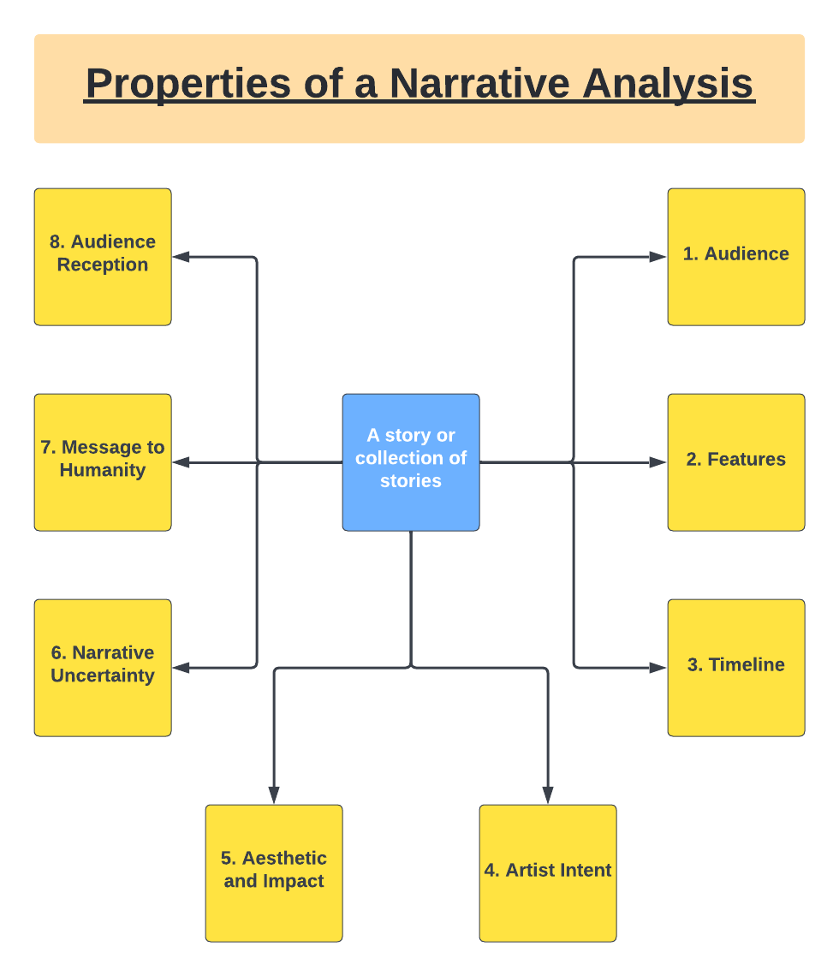
Narrative Analysis
There are two main versions of narrative analysis:
socio-linguistic which focuses on ‘incidents or the structure of narratives and how they convey meaning
socio-cultural which looks at the broader interpretive frameworks that people use to make sense of incidents in individual’s lives
Issues?
Story authentic? (Faking the data possible)
Is the story real? (Participants may not be able to tell the real story)
Who owns the story? (Does the researcher have permission to share it?)
Is participants voice lost?
Does the researcher gain at the expense of the participant?
Notes:
Is a qualitative research method that focuses on the stories people tell to understand how they make sense of their experiences. Rather than simply examining what people say, it looks at how they structure their accounts, what themes emerge, and the meanings behind their narratives.

Slide 19
Grounded Theory Analysis
Why qualitative method? It’s on personal experience… Qualitative methods help to find out, what’s behind the phenomenon.
Grounded Theory To develop a theory or a model on the base of empirical data. Grounded Theory Method gives structure for Data collection, data analysis and development of a theory or model.
Data collection methods - guided interviews - observation
Analytic methods: - coding
data collection
coding and analysis

Slide 20
Grounded Theory Analysis
Data Collection and Analysis in Tandem:
Data collection and analysis occur simultaneously. This iterative approach means that initial data analysis informs subsequent data collection, allowing theories to evolve as more data is gathered.
Example: If conducting interviews on cybersecurity practices, initial coding might reveal unexpected concerns around data privacy, prompting further questions in later interviews.
Coding Process in Grounded Theory:
Open Coding: Break down the data into discrete parts, closely examining each part to identify concepts and assign codes.
  Example: A researcher might code statements related to "trust," "security," or "convenience" when analysing user interviews about online services.
Axial Coding: Link the open codes by identifying relationships between them, organizing these codes into categories or sub-themes.
  Example: Grouping codes like "trust" and "security" under a broader category of "User Concerns."
Selective Coding: Identify the central theme or core category that represents the main idea of the research, integrating all other categories around it.
  Example: Concluding that "Trust in Security" is the core concern, integrating other codes to explain factors that influence trust.
Theory Development:
Grounded Theory aims to produce a theory that explains the phenomena being studied, grounded entirely in the data collected. The final theory is often a framework that connects the main categories and subcategories identified through coding.
Example: Developing a framework for understanding user trust in online platforms, which could highlight the roles of perceived security, ease of use, and support services.
Notes:
Grounded Theory is a systematic approach to qualitative data analysis that aims to develop theories based on data collected. Useful when no pre-existing theory adequately explains the data. It allows researchers to construct new theories directly from empirical data.

Slide 21
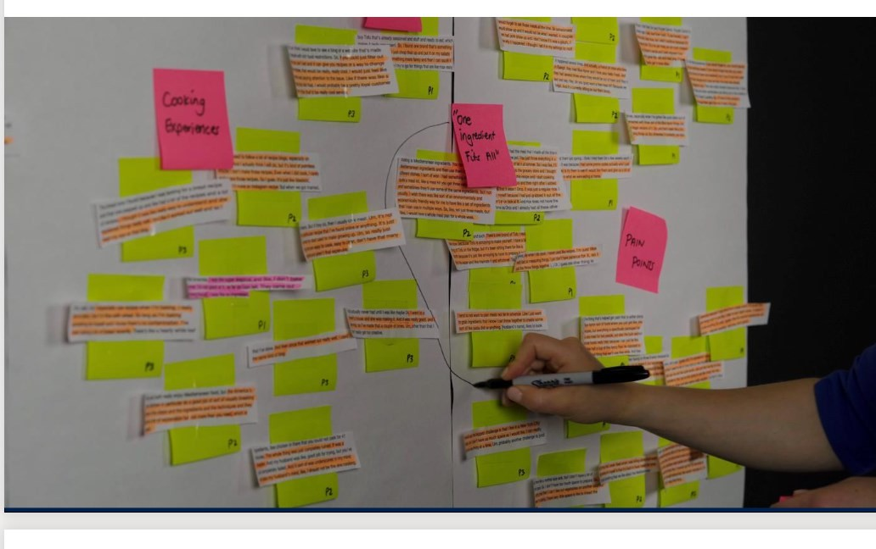
Thematic analysis
Thematic analysis is a systematic method of breaking down and organizing rich data from qualitative research by tagging individual observations with appropriate codes, to facilitate the discovery of significant themes.
The themes are identified from the data.
–First, we have to read and understand the data
–Then we break it down into “chunks”
–Then we code the data

Slide 22
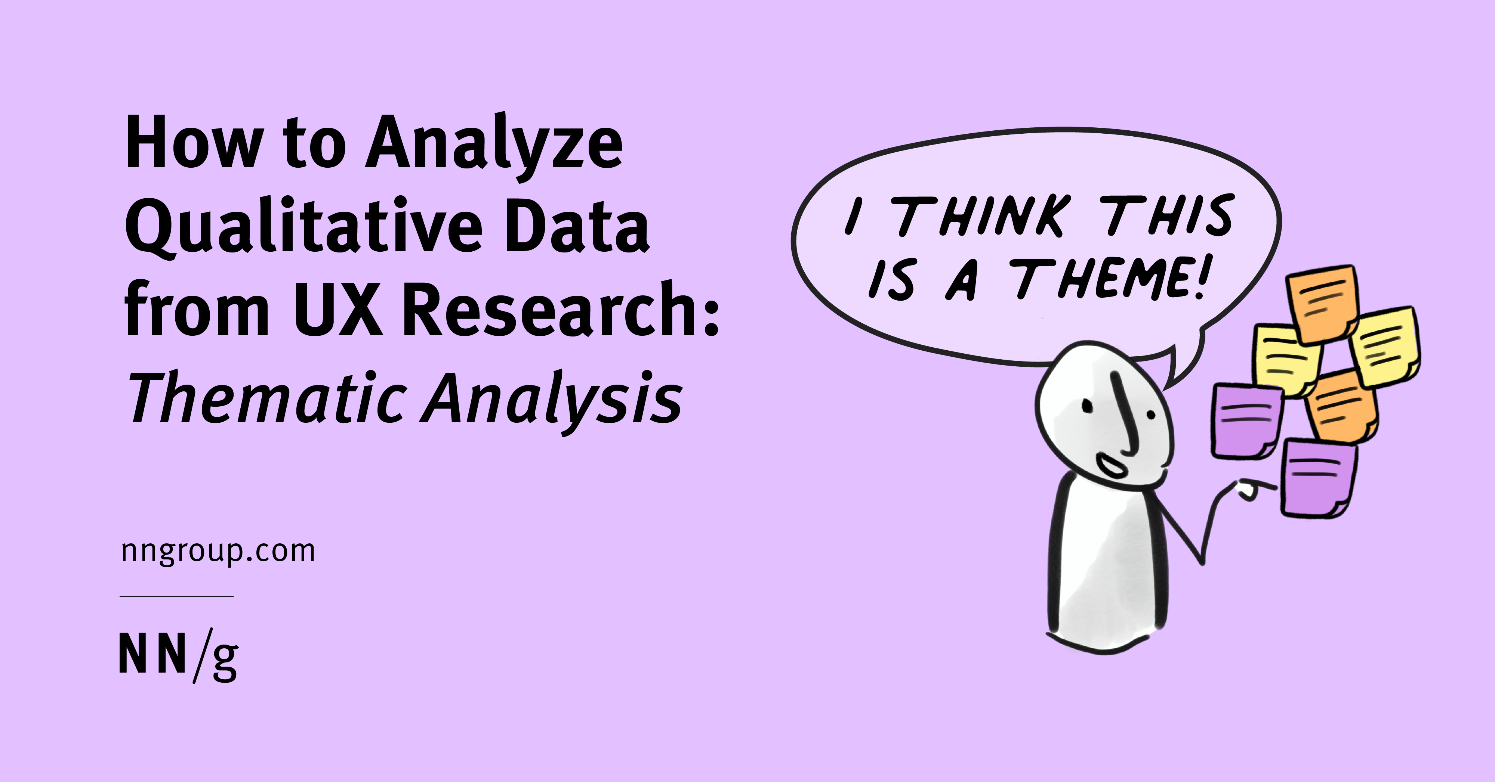
Thematic Analysis - Reading and Chunking
Separate big blocks of text into smaller ones.
Each block should be an idea
  Usually sentences
Read multiple times
  Read closely
We are not interested in the specific words that are used, but rather the meaning of them.
  Or What is this person telling us?

Slide 23
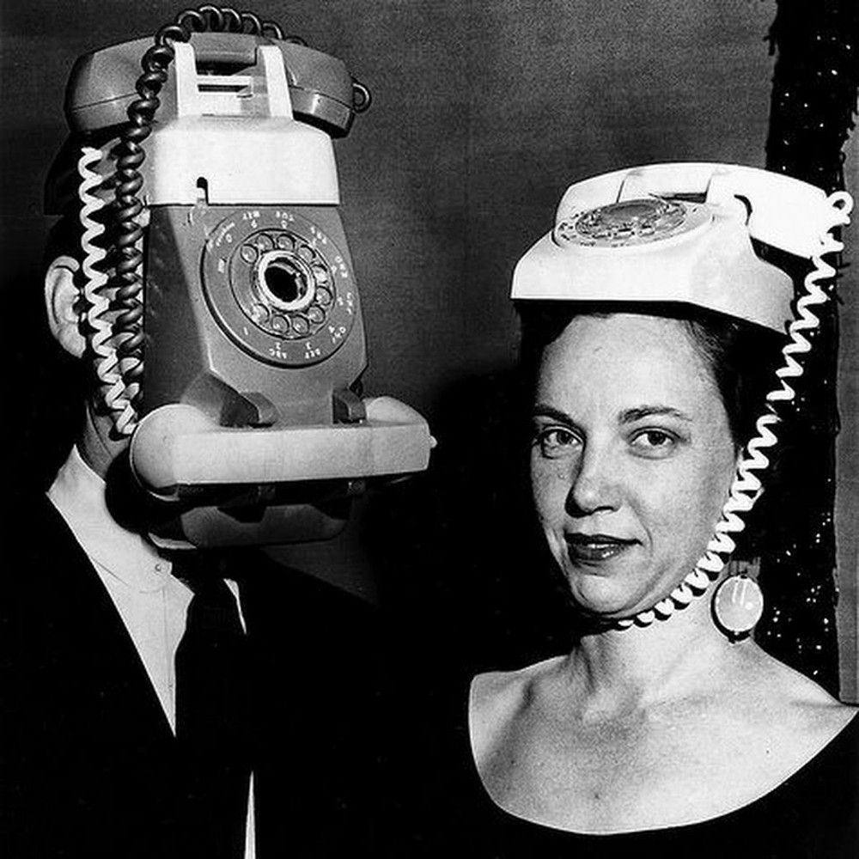
Thematic Analysis - Reading and Chunking
Suppose we are evaluating why fewer elderly users buy smart phones?
We have text from multiple interviews, one of these is shown below:
“I love how many different cases it comes with. I enjoy switching them up now and then, and I always choose the sleek, modern colors. When my neighbour drops by for cake, I often get compliments. However, the text on the screen is a bit small, and if I increase the size, there's only space for a few words. But my daughter is always there to help if I need it, so it’s not really an issue. Plus, I don’t do much reading on it anyway.”
What is the key point here?

Slide 24

Thematic Analysis - Reading and Chunking
Suppose we are evaluating why fewer elderly users buy smart phones?
What is the key point here?
“I love how many different cases it comes with. I enjoy switching them up now and then, and I always choose the sleek, modern colors. When my neighbour drops by for cake, I often get compliments. However, the text on the screen is a bit small, and if I increase the size, there's only space for a few words. But my daughter is always there to help if I need it, so it’s not really an issue. Plus, I don’t do much reading on it anyway.”
Notes:
1. Aesthetic and Customization Satisfaction
Theme: Enjoyment of Appearance and Variety
Evidence: The user expresses enjoyment in the number of cases available and takes pleasure in changing them up frequently. They also favor “sleek, modern colors,” indicating an appreciation for the aesthetic appeal and the ability to personalize the device.
Interpretation: The customization aspect of the device is important to the user, suggesting that they value aesthetics and the option to make their device feel unique or adaptable to their mood or environment.
2. Social Interaction and Validation
Theme: Social Approval and Positive Feedback
Evidence: The user mentions receiving compliments from their neighbor when they visit, which may imply that social interactions are enhanced by the appearance of the device.
Interpretation: Positive feedback from others may reinforce the user’s satisfaction with the device, linking social approval to their enjoyment. This also suggests that the user enjoys sharing aspects of their device experience with others, making social validation a subtle motivator in their preferences.
3. User Experience Challenges
Theme: Issues with Text Display Size
Evidence: The user mentions that the “text on the screen is a bit small” and notes a limitation in displaying text if they increase its size, leading to fewer words fitting on the screen.
Interpretation: This theme highlights a usability challenge, particularly regarding readability. Although the user doesn't view it as a major issue, this limitation could impact users who require larger text sizes for comfortable reading.
4. Support from Family
Theme: Reliance on Assistance
Evidence: The user mentions that their daughter is available to help if needed, especially with any difficulties that may arise due to the small text.
Interpretation: This suggests a dependency on family support for certain tasks, implying that while the device may have usability issues, the user can overcome them with assistance from loved ones. It also hints at a familial bond, where the daughter plays a role in making the device accessible.
5. Limited Purpose and Usage
Theme: Minimal Use for Reading
Evidence: The user states that they don’t do much reading on the device, which downplays the importance of the small text issue.
Interpretation: This shows that the user primarily uses the device for purposes other than reading, which could make aesthetic and social aspects more important to them than functionality for reading. This could also indicate a user who engages in lighter or non-intensive tasks on the device.

Slide 25
Example: Qualitative Data
Here is some of the feedback received from adults, regarding their experience of
using technology (unstructured or Informal Conversations):
“I find the size of the text on the iPhone screen too small, and if you make it bigger, then there’s not a lot of space for more than a few words. It’s just not practical.”
“I’ve yet to find a desk chair that doesn’t make my back hurt more than it already does.”
“I love Skype most of all. Sometimes I have to ask my daughter to get it to work, but when it does it’s so convenient and lets me connect with my grandkids.”
“I can’t get it to work. SMS, email and now whatsapp and facebook… It’s all too confusing.”

Slide 26
Coding example
Here is some of the feedback received from adults, regarding their experience of
using technology (unstructured or Informal Conversations):
“I find the size of the text on the iPhone screen too small, and if you make it bigger,
then there’s not a lot of space for more than a few words. It’s just not practical.”
make my back hurt
“I’ve yet to find a desk chair that doesn’t more than it already does.”
“I love
Skype
most of all. Sometimes I have to ask my daughter to get it to work,
but when it does it’s so
convenient
and lets me connect with my grandkids.”
“I can’t get it to work. SMS, email and now whatsapp and facebook…
It’s all too confusing”

Slide 27
Coding - Chunking
We will crop the selected chunks from all original sentences and then focus on only those chunks.
text on the iPhone screen too small
make my back hurt
Skype
ask my daughter to get it to work,
convenient
SMS, email and now whatsapp and facebook
It’s all too confusing”
Next what we are going to do with these?
We can refine or distill them further. We are going to remove the actual content and convert them into concepts.

Slide 28
Coding – Conversion to Concepts
have changed “make my back hurt”, into physical discomfort
Physical discomfort
Avoid physical activity
Not Practical
Convenient
Complex app ecosystem
Useful apps
Confusing
Require assistance
Next what we are going to do with these?
We can generate some Categories from these Concepts

Slide 29
Axial Coding – Relating Concepts to Categories
So here is Axial Coding where we align the Concepts to the most relevant Categories
Categories could be:
Physical discomfort
Avoid physical activity
Physical
Practicality
Application
Ease of Use
Not Practical
Convenient
Complex app ecosystem
Useful apps
Confusing
Require assistance
Next What we are going to do next?
We can create a 2nd Axis that differentiates between Positive and Negative
Concepts for each Category

Slide 30
Axial Coding
Negative concepts are terms as Barriers and Positive concepts are termed as Opportunities.
So i.e. there are physical opportunities that allow you to avoid physical activity.
Physical discomfort
Avoid physical activity
Physical
Not Practical
Convenient
Practicality
Complex app ecosystem
Useful apps
Applications
Confusing
Require assistance
Ease of Use
Barriers
Opportunities

Slide 31
Coding
Remember, we started from unstructured text and now we have generated some nice-looking structured data.
Right now there's not a lot to say other than there's quite a few ‘Ease of Use’ categories on barriers than anything else. That suggest ‘Ease of Use’ to be the main thing to focus on.
In real-life scenarios, where we will collect data from several dozen participants, in that case our table will be lot more populated and then you can start seeing a lot more stronger relationships on which some good Analysis/recommendations can be made.
For example, at the end of Coding, you may see that ‘Ease of Use’ category pops up quite a lot as a Barrier, so we have
The more data you have better, the more refined theory you can produce.

Slide 32
Generating Conclusions
Greatly depends on the data that emerged and the nature of the investigation.
Examples of conclusions:
  A comparison between variables (e.g. comparison between frequency of physical barriers for male and female elderly).
  You can have a recommendation for future design, (e.g. primary barrier/problem is cognitive).
So we should focus on documentation and tutorials, rather than Technology aspects.

Slide 33
Multi-modal data
Have focused so far on text analysis…
Could equally apply similar methodologies (qualitative methods generally) to data in other modalities
Audio data: e.g. recordings of interviews, conversations, etc. Perhaps start with a transcript, then apply thematic analysis, etc
Video data: e.g. recorded interactions, performance, etc. Could code the behaviour by trained coders working from an established code book

Slide 34

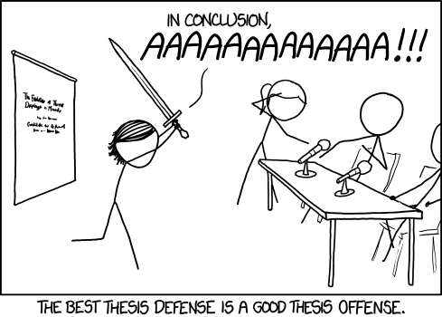
From this point on…you’re a scientific researcher!
Congratulations
Mad or otherwise

Slide 35
Thematic Analysis
Duration: 40 minutes
Objective: To help students develop a deep understanding of thematic analysis as a qualitative research method. The task encourages students to identify themes within a given dataset, analyse how these themes are developed, and reflect on the methodological choices involved in thematic analysis..
Task Description
Dataset Review (10 minutes):
Each group will select a qualitative dataset (e.g., interview transcripts, focus group discussions, or open-ended survey responses) relevant to a specific research topic (e.g., healthcare, technology adoption, workplace diversity, etc.).
Initial Coding (10 minutes):
Each group will identify and list initial codes based on recurring ideas, phrases, or patterns in the text. Discuss as a group which codes seem most relevant to the research question or topic.
Theme Identification (10 minutes):
After coding, group similar codes together to create 2-3 overarching themes. Write a brief description of each theme and justify why these themes were chosen.
Quick Reflection (10 minutes):
Reflect on the process: What challenges did your group face? How might thematic analysis be useful in research?

Slide 36

Reflection & Writing – 10 Mins
Spend 10 mins just writing, you can either reflect on today’s lesson, capture ideas for a dissertation, reflect on today’s topics and how can they be applied to your research
Free write if you like also – just simply write.

Slide 37

Questions??
Or answers ?

